Slide 1
Searching Algorithms

Slide 2
Searching Algorithms
Algorithm that finds the presence/position of a specific value within a collection of data
The specific value – the search key
Two common and popular searching algorithms:
Linear Search
Binary Search

Slide 3
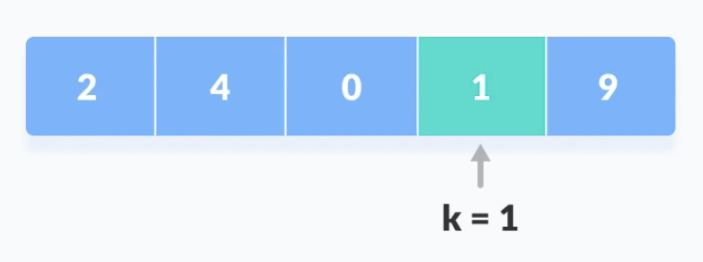
Linear Search
Linear search is a sequential searching algorithm
We start from one end and check every element of the list until the desired element is found.
It is the simplest searching algorithm.
Not found (k=3)

Slide 4
Linear Search
def linear_search(arr, key): for i in range(len(arr)): if(arr[i]==key): return i #Found at index i return -1 #Not found arr = [3, 1, 5, 8, 9, 0] print(linear_search(arr, 8)) print(linear_search(arr, 4))

Slide 5
Linear search runtime analysis
Best case
[25, 45, 66, 77, 89, 11] K=25
Ω(1)
Cases
Average case
[25, 45, 66, 77, 89, 11] K=77
θ(N)
Worst case
[25, 45, 66, 77, 89, 11] K=100
O(N)
Note: N is the length of the list / number of items in the list

Slide 6
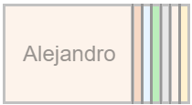
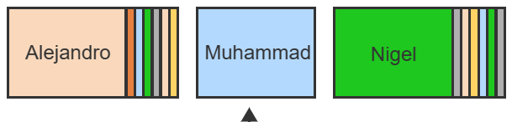
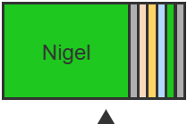
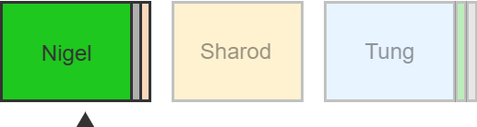
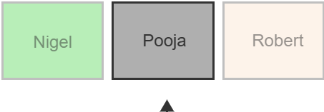
Searching a contact on your phone
Contacts
(sorted)
K = ‘Pooja’

Slide 7
Binary Search
Binary search is a faster algorithm for searching a list if the list's elements are sorted
In this approach, the element is always searched in the middle of a portion of the list.
low
mid
high

Slide 8
Binary Search
Sort the array in ascending order*
Set low = first, high = last (represents index)
Set mid = (low + high)/2
If target == arr[mid], return mid
Elif target<arr[mid], set high = mid-1.
Else low = mid + 1
Repeat steps 3-6 until the element is found
or the element is not present in the list.
Target = 23
12 | 23 | 42 | 55 | 56 | 77 | 79
low
mid
high
mid
high

Slide 9
Case when the target is not found
Target = 2
12 | 23 | 42 | 55 | 56 | 77 | 79
low
mid
high
mid
high
low
mid
high
low = 0
mid = 0
high = 0
low = 0
mid
high = -1
high = mid - 1
low > high
STOP

Slide 10
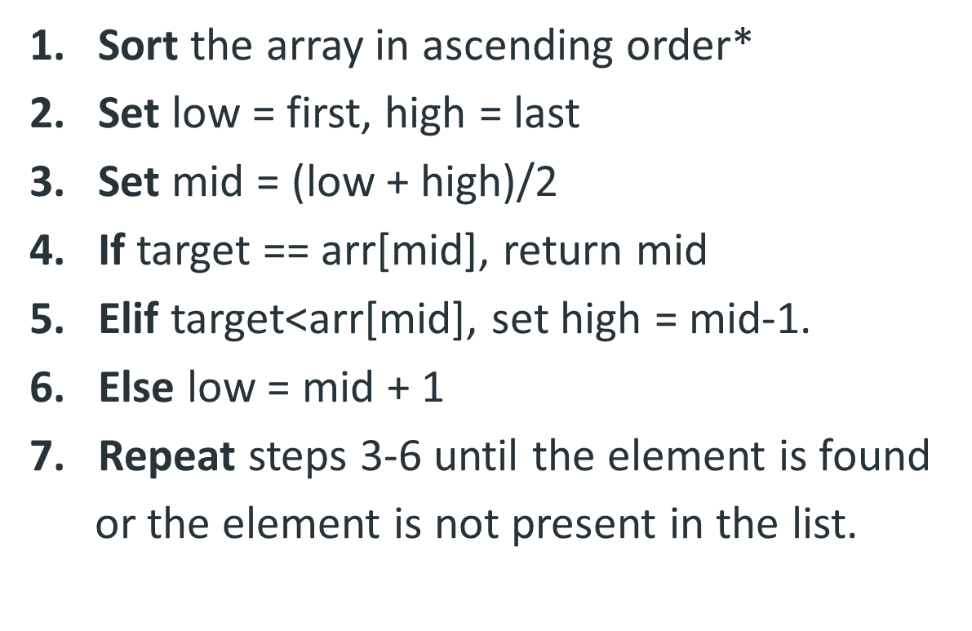
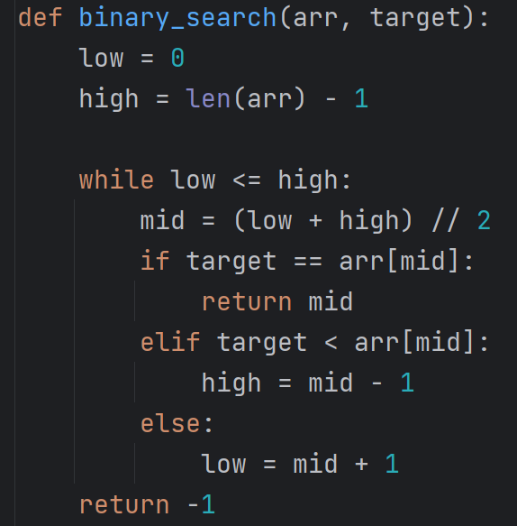
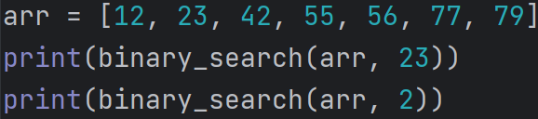

Binary Search implementation

Slide 11
Binary Search recursive implementation
low
mid
high
Base cases:
low > high
arr[mid] == target
Recursive structure:
binary_search(low, high)
= binary_search(low, mid-1)
or
binary_search(mid+1, high)
low
mid
high
target < arr[mid]
target > arr[mid]
low
high
low
high

Slide 12
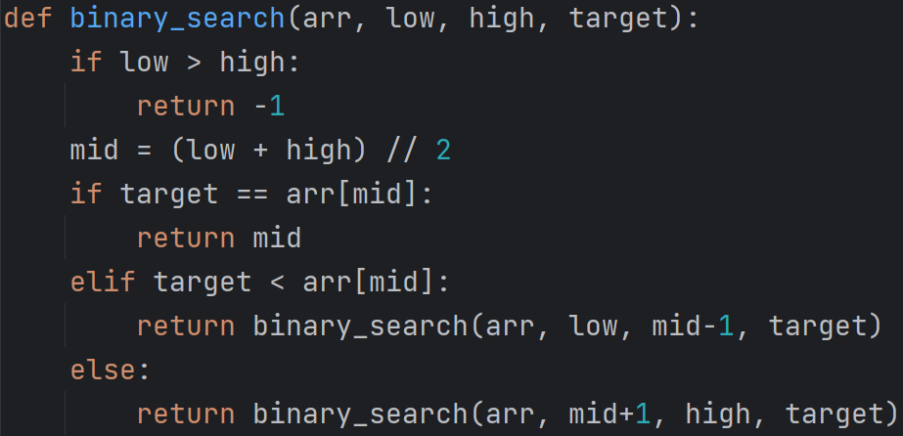
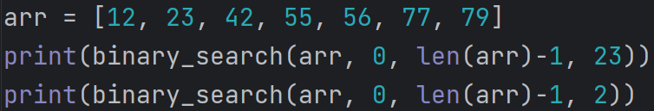
Binary Search recursive implementation

Slide 13
Binary search runtime analysis
Best case
[12, 23, 42, 55, 56, 77, 79] target=55
Ω(1)
Cases
Average case
[12, 23, 42, 55, 56, 77, 79] target=56
θ(logN)
Worst case
[12, 23, 42, 55, 56, 77, 79] target=2
O(logN)
Note: N is the length of the list / number of items in the list

Slide 14
Why the time complexity of binary search is O(logN)?
binary search reduces the search space by half
because it repeatedly dividing n by 2 until it reaches 1
This characteristics leads to a time complexity of O(logN)
Example
log₂128 = 7
If we have an array of length 128, it will take at most 7 recursive calls
128 > 64 > 32 > 16 > 8 > 4 > 2 > 1
So, for an array of length n, the algorithm needs log₂N steps.
Therefore, the time complexity = O(log₂N) ~ O(logN)

Slide 15
Summary
Binary search is incredibly efficient in finding an element within a sorted list
Each subsequent search reduces the search space by half ~ O(logN)
Requires the list to be sorted

Slide 16
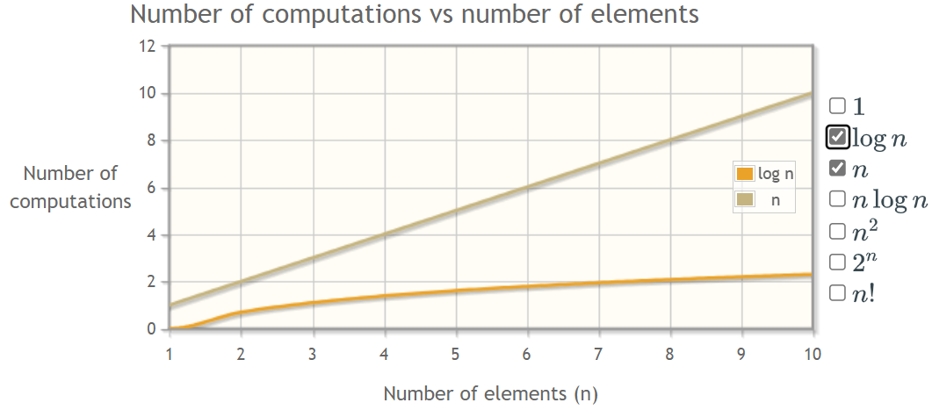
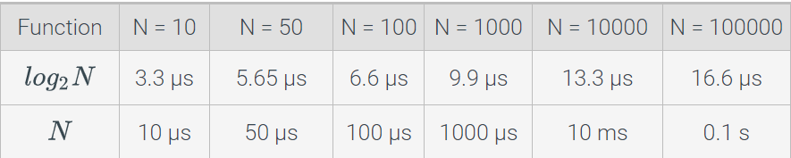
Linear Search vs Binary Search

Slide 17
Binary search - Exercises
Write a binary search algorithm that can search an array sorted in descending order.
Write an order-agnostic binary search algorithm that can search a sorted array (works for both ascending and descending order).

Slide 18
Binary search + Recursion
Implement a method called binary_sum() that accepts a list as input and recursively calculates the sum using a strategy similar to the binary search.

Slide 19
Recommended Reading:
16.1 Searching and algorithms
16.2 Binary Search

Slide 20
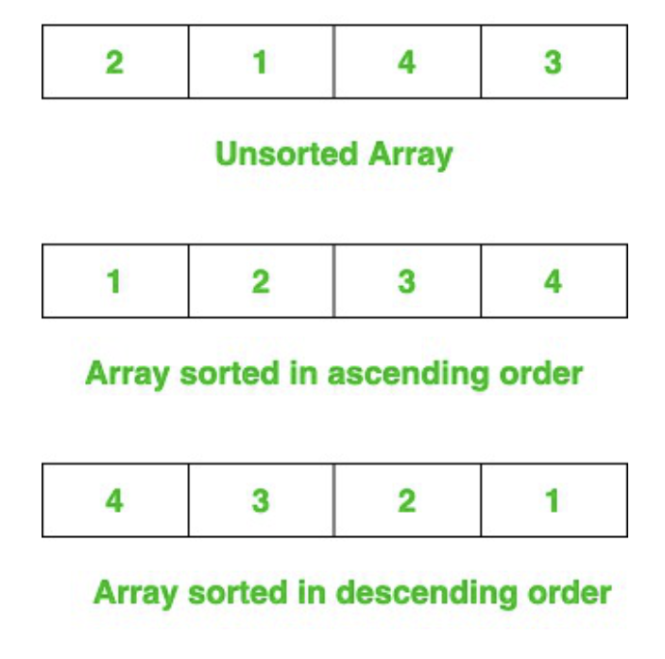
Sorting Algorithms
Sorting is the process of converting a list of elements into ascending (or descending) order
Swapping values is an important part of several sorting algorithms.
Applies to – list of numbers, strings, objects etc.
Here, we focus on sorting a list of numbers

Slide 21
Bubble Sort
Bubble Sort is a simple sorting algorithm.
This sorting algorithm repeatedly compares two adjacent elements and swaps them if they are in the wrong order.
It has a time complexity of O(n²) in the average case.

Slide 22
12
7
3
11
23
12
7
3
23
11
12
7
23
3
11
12
23
7
3
11
23
12
7
3
11
23
12
7
3
11
23
12
7
11
3
23
12
11
7
3
23
12
11
7
3
23
12
11
7
3
23
12
11
7
3
23
12
11
7
3
23
12
11
7
3
23
12
11
7
3
Sorting [23, 11, 3, 7, 12] in ascending order

Slide 23
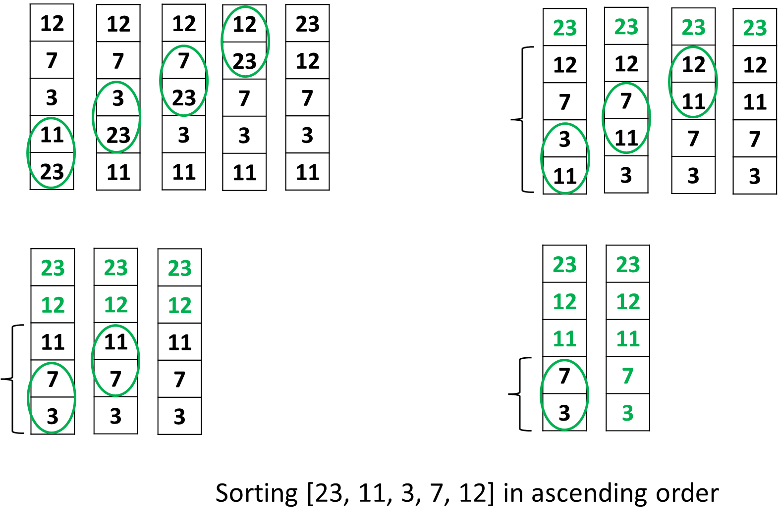
Pass 0 – 4 comparisons
Pass 1 – 3 comparisons
i | j
0 | 4
1 | 3
2 | 2
3 | 1
Pass 2 – 2 comparisons
Pass 3 – 1 comparisons

Slide 24
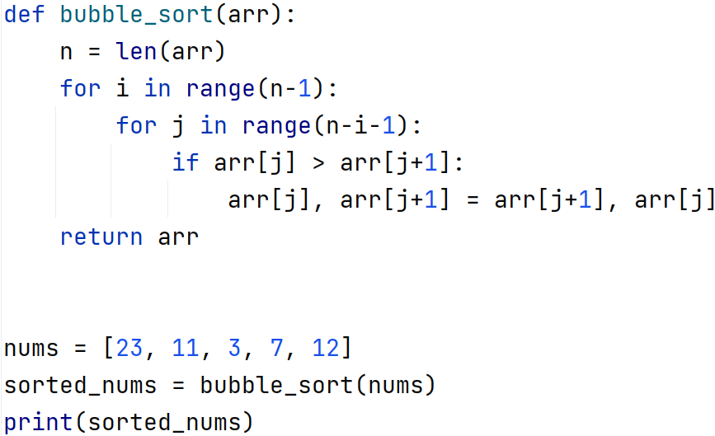
Bubble Sort: Python implementation
i | j
0 | 4
1 | 3
2 | 2
3 | 1
What will be the output?
print(nums)

Slide 25
Sorting Exercise – Bubble Sort
11
12
1
9
6
5
4
7

Slide 26
Bubble Sort – Descending Order?

Slide 27
Attendance

